Slide 1
Presentation on: Superheterodyne Receiver
PRESENTED TO
IMRAN HOSSAIN
ASSISTANT PROFESSOR
DEPARTMENT OF ICT
COMILLA UNIVERSITY
PRESENTED BY
FAZILATER NESSA AFRIN
ID NO.11709030
DEPARTMENT OF ICT
COMILLA UNIVERSITY

Slide 2
Outline
Introduction
Stages of Superheterodyne receiver
Block diagram of Superheterodyne receiver
Working principle of Superheterodyne receiver
Advantages
Disadvantages
Application

Slide 3
Heterodyning:
The process of mixing two signals having different frequencies to produces a new frequency is called as heterodyning.and the super heterodyning is that where the local oscillator signal is greater than the RF signal .
The super heterodyne receiver converts every selected RF signal to a fixed lower frequency called as ‘intermediate frequency’

Slide 4
Stages of superheterodyne receiver:
Antenna
RF stage
Mixer
Local oscillator
IF amplifier
Detector
AGC circuit
Audio amplifier
Power amplifier
Speaker

Slide 5
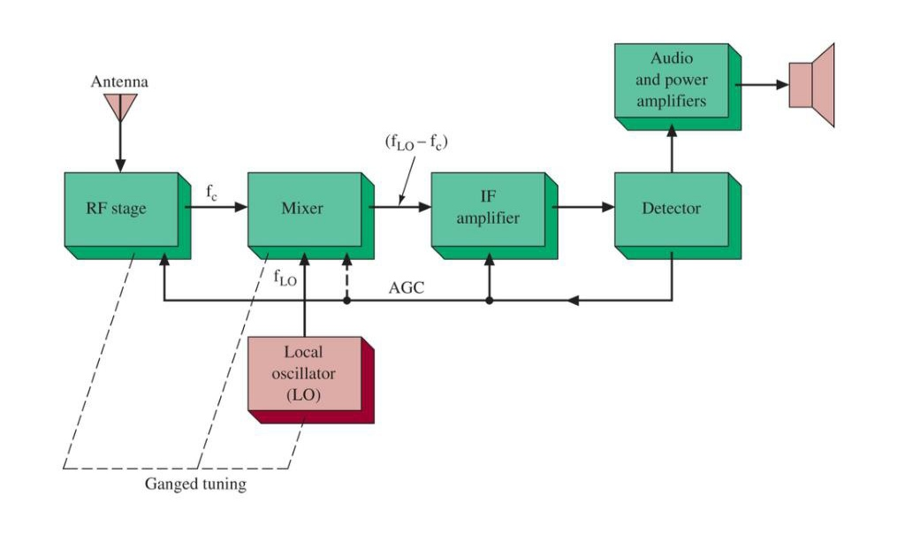
Block diagram:

Slide 6
Working principle :
The aim signal transmitted in the form of electromagnetic wave. When received induces a small voltage in the receiving antenna.
RF is an amplifier which selects required signal, rejects other signal, reduces effect of noise.
The output from the RF is called fc .
Mixer received two input one from RF amplifier and other from local oscillator. Satisfying the conditions 1.flo>fc
2.Mixes these two signals
3.Generates signals(flo-fc),(flo+fc).
(flo-fc)is selected and all other are rejected. (flo-fc)is called IF frequency. The IF frequency now amplify.
The amplified IF frequency is detected by the detector to recover the original modulating signal. This signal is then applied to the loud speaker.
AGC circuit control the gain of RF and IF.

Slide 7
Advantages
No variation in the bandwidth.
High sensitivity.
High selectivity.
High fidelity.
High adjacent channel rejection.

Slide 8
Disadvantages:
Difficult to integrate .
Very high Q filters are required.

Slide 9
Application
AM
FM
Single sideband
Television
Radar

Slide 10
Thank you

